Slide 1

D. Y. Patil College Of Engineering, Akurdi, Pune
Group Number: 28
Group members:
Mayuresh Harihar BEAIDB33
Manas Pandey BEAIDB39
Mangesh Raj BEAIDB34
Sahil Khangar BEAIDB40
BE Project Stage I
Review-I Presentation
AI based Inventory Optimisation System for Restaurants
Mrs. Pallavi Shingade
(Project Guide)
Mrs. M. D. Karajgar
Dr. B. A. Tingare
(Project Co-ordinator)
Dr. V. G. Kottawar
(HOD, AI & DS)

Slide 2



Abstract
The "AI-based Inventory Optimisation System for Restaurants" aims to develop an intelligent and data-driven solution to minimize food wastage in restaurants. The system will leverage artificial intelligence and data science techniques to analyze historical sales data, customer preferences, and environmental factors to predict demand accurately and optimize food preparation. By reducing food waste, the project seeks to promote sustainable practices, save costs, and contribute to a greener environment.

Slide 3



Problem Statement
The project aims to tackle the problem of food wastage in restaurants, caused by inaccurate demand forecasting, improper inventory management, and inefficient menu planning. The lack of data-driven decision-making leads to overproduction, spoilage, and unsold food items. This project seeks to optimize the restaurant's operations to minimize food waste while maintaining customer satisfaction.

Slide 4
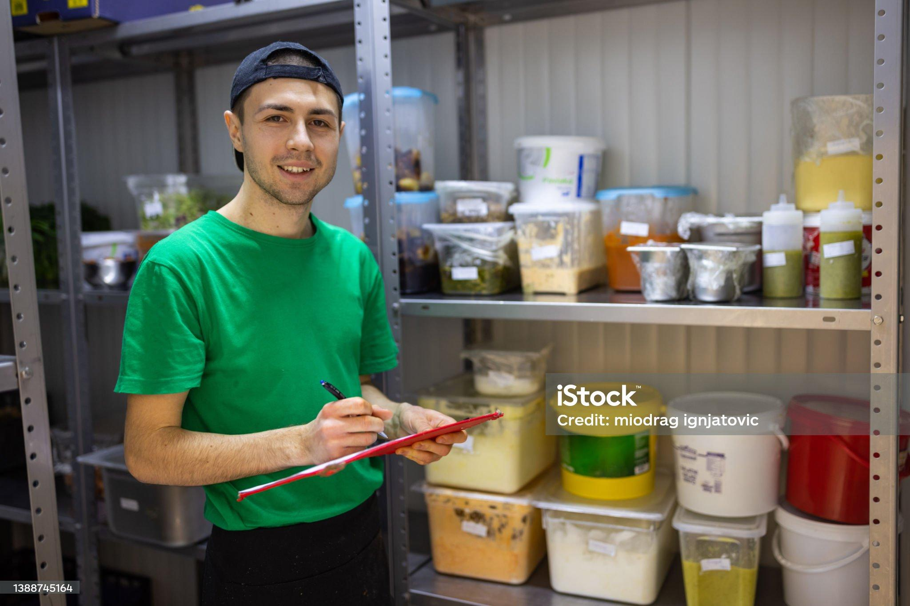
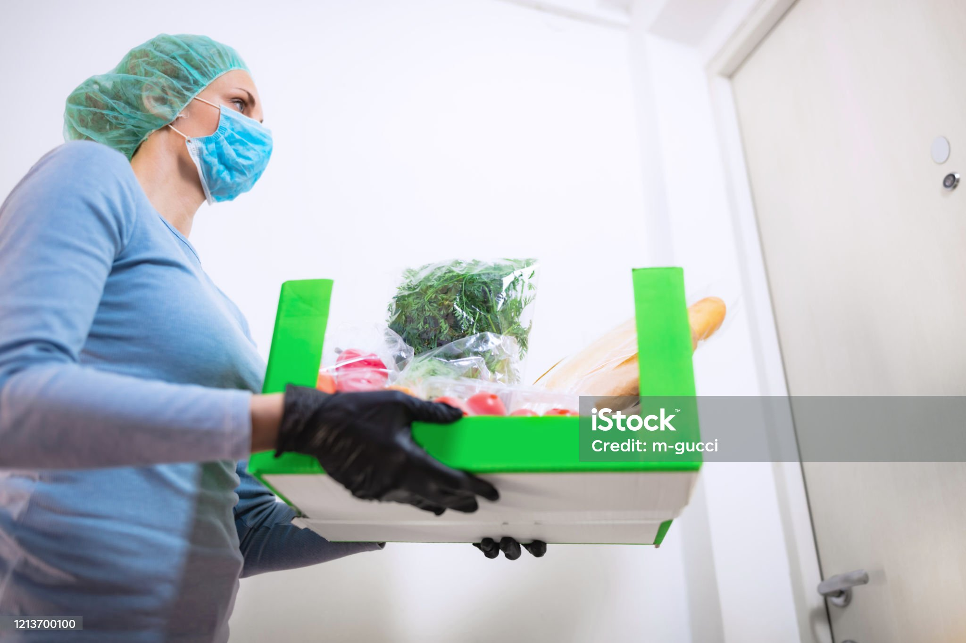
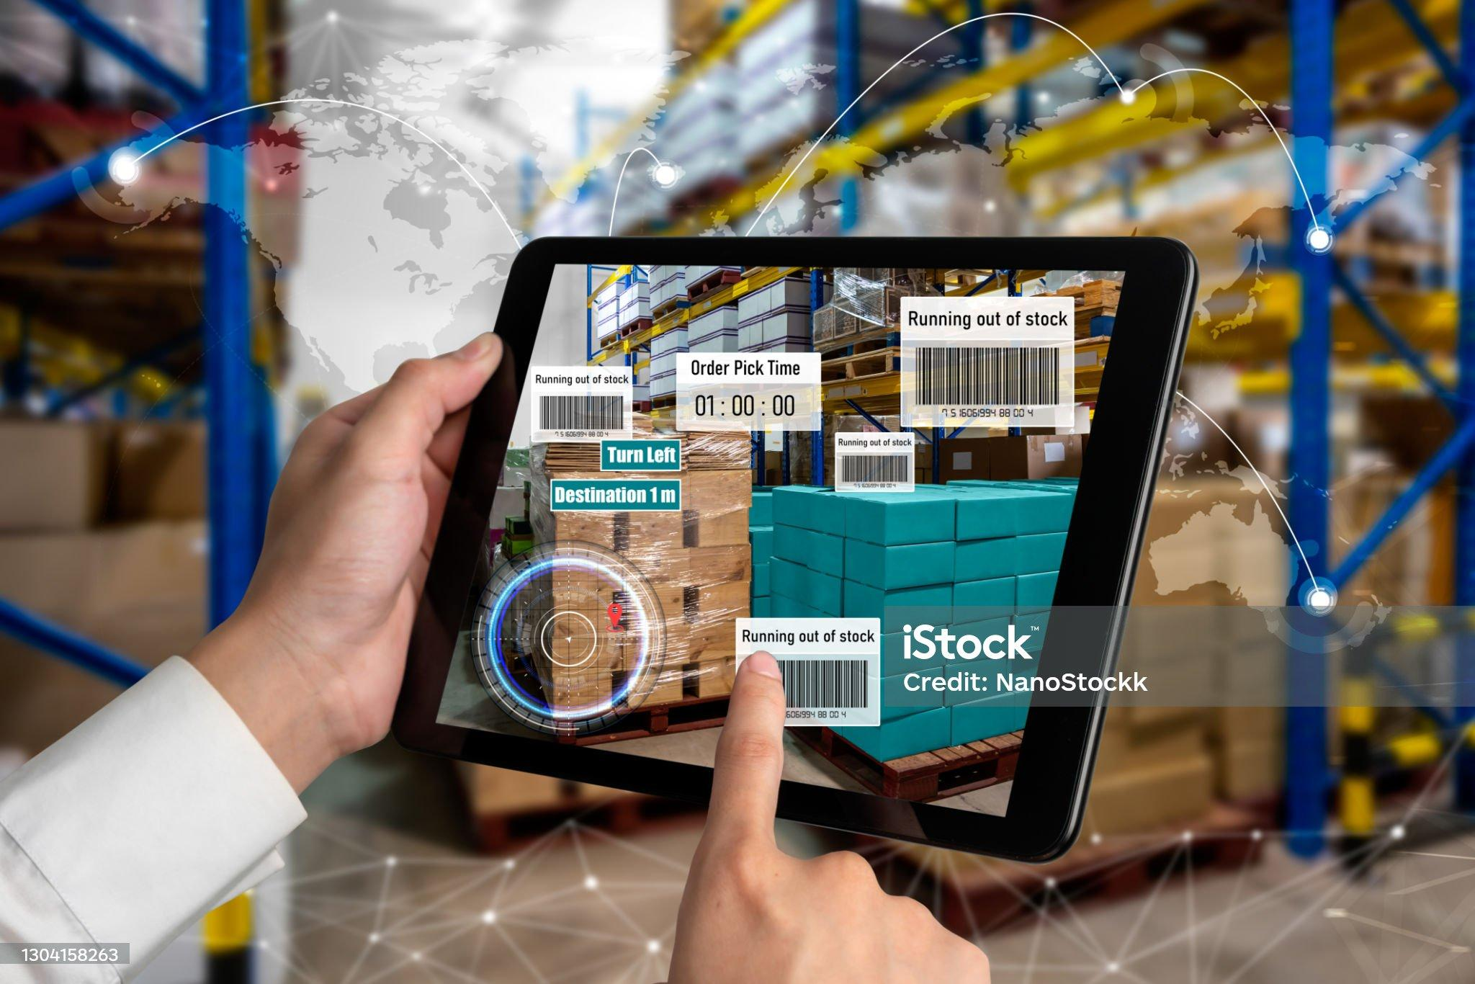
Literature Review
Introduction to Food Inventory Management in Restaurants.
Food inventory management is crucial in restaurants, impacting cost control, food safety, and sustainability. It involves procurement, tracking, and forecasting to ensure the availability of fresh ingredients while minimizing waste. Modern technology, like inventory software, aids in real-time monitoring. Restaurants must also consider sustainability, local sourcing, and waste reduction to meet changing consumer demands. Challenges include cost control and adapting to industry trends.
Discussion of food waste reduction efforts in the hospitality sector.
In the hospitality sector, which includes restaurants, hotels, and catering services, has recently become more aware of its significant role in creating food waste.There efforts to reduce food waste have gained momentum due to ethical and environmental concerns. Strategies include source reduction through better menu planning and portion control, donations to charities, technology-driven help, staff training, and the implementation of responsible food waste laws and rules.
The role of AI and data science in optimizing inventory management.
AI and data science have revolutionized inventory management by providing advanced tools and techniques to optimize processes across industries. AI-driven demand forecasting enables precise stock level predictions, minimizing overstock and stockout risks. Data science algorithms categorize items, allowing tailored inventory strategies. Real-time visibility, dynamic pricing, and risk assessment enhance efficiency and adaptability.

Slide 5


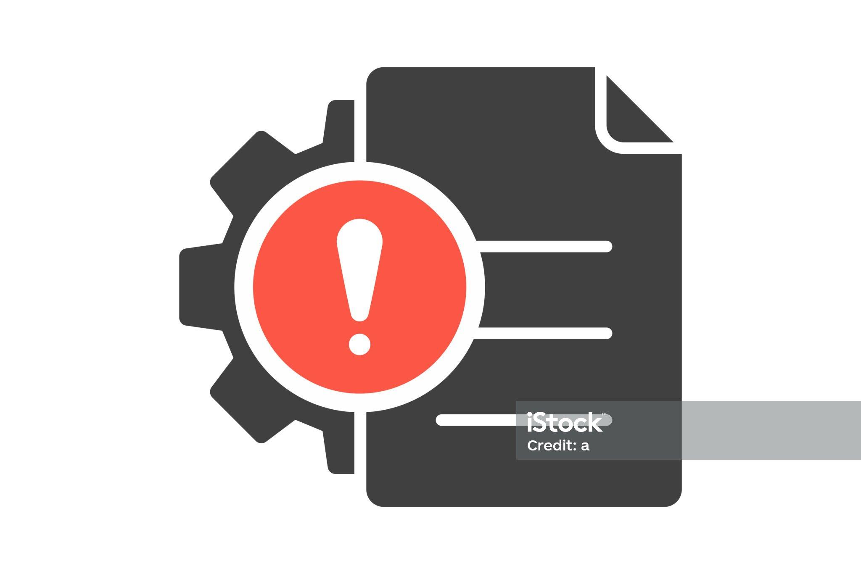
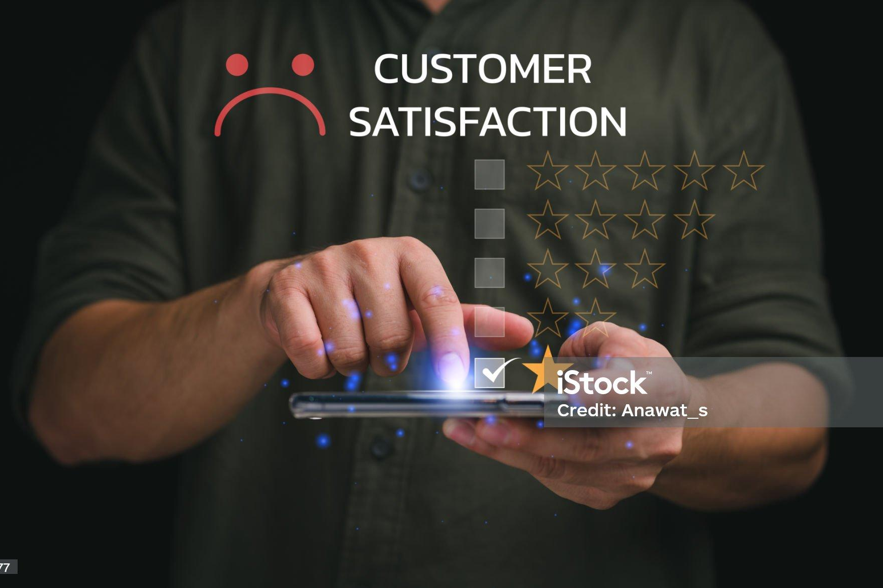
AI applications used in the Restaurant industry.
AI is revolutionizing the restaurant industry with voice-assisted ordering, AI phone answering, smart staff scheduling, and automated marketing. AI-powered tools can handle routine tasks, easing the burden on employees. These innovations streamline operations, enhance customer service, and optimize resource management..
The significance of demand prediction models in reducing food waste.
Every 1% increase in improved demand forecasting results in a 2% reduction in cost. Demand prediction models are vital for reducing food waste in the food industry. They minimize overproduction, reduce spoilage, offer financial benefits, and enhance menu planning, resulting in cost savings and improved customer satisfaction.
The use of alert mechanisms in inventory management and their impact on food waste reduction.
Alert mechanisms in inventory management are essential for waste reduction, promoting proactive and efficient operations. They prevent stockouts and overstocking, enhance shelf life management, and ensure quality control, ultimately minimizing environmental and financial costs associated with waste.
How recommendation systems are employed to enhance customer experience and reduce waste.
Recommendation systems in the food industry enhance customer experiences by offering personalized menu suggestions and contribute to waste reduction through improved inventory management and dynamic pricing. These systems benefit both customers and businesses by reducing costs and environmental impact.

Slide 6




Module-wise-Algorithm
M2- Demand Prediction Model
M4-Alert Mechanism
by ML (Demand Prediction)
by Threshold-Based Alerts
M3-Recommendation System
M5. Feedback Loop and Data Analytics
M1- Food Inventory Management
by Image Recognition
by Recommendation Algorithm
by Feedback Analysis Algorithm

Slide 7


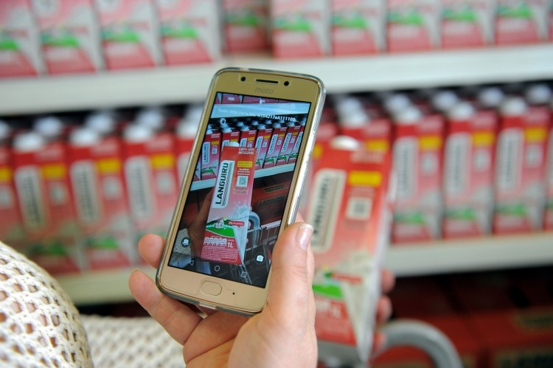
Food Inventory Management
Text Detection and Parsing
Implement OCR techniques using libraries like Tesseract.
Detect text regions containing item details, including names, quantities, and expiration dates.
Feature Extraction with CNN
Information Extraction
Parse text regions to extract relevant information.
Separate and extract item names, quantities, and expiration dates.
Utilize pre-trained CNN models like VGG, ResNet, or Inception.
Load model weights and architecture for feature extraction.
Data Storage and Repetition
Image Preprocessing
Resize input images (e.g., 256x256 pixels).
Normalize pixel values for consistent lighting conditions and apply noise reduction (e.g., Gaussian blur).
Store extracted information in the inventory database, associating it with specific food items.
Repeat steps for each image in the inventory if necessary.

Slide 8
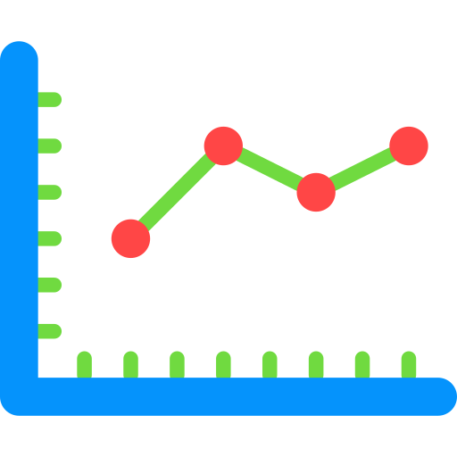
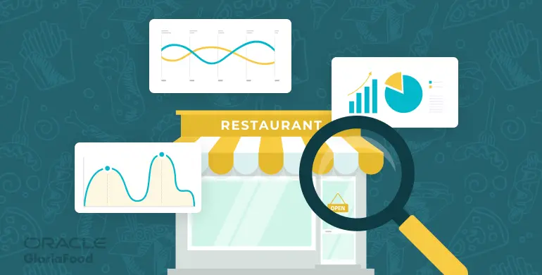
Demand Prediction Model
Hyperparameter Tuning
Optimize model parameters if necessary.
Model Building
Choose and train a machine learning model.
Define performance metrics for evaluation.
Model Evaluation
Assess model performance on a testing dataset.
Data Preparation
Combine data with additional factors.
Handle missing values, outliers, and normalize features.
Demand Prediction
Apply the trained model for future demand predictions.

Slide 9


Recommendation System
Include about-to-expire food items
Include about-to-expire food items in the recommendations.
To avoid food wastage and increase profitability
Generate Recommendations
Identify High-Demand Items
For high-demand items, create recommendations as daily specials.
Consider factors like predicted demand, historical popularity, seasonality, and customer preferences.
Analyze data to find items with significantly higher predicted demand than current inventory.
Establish a threshold for identifying high-demand items.
Performance Tracking and Adjustment
Data Integration
Combine predicted demand with current inventory data.
Ensure recommendations consider both demand forecasts and actual inventory levels.
Continuously monitor the performance of recommended daily specials.
Adjust recommendations based on real-time sales data, customer feedback and inventory levels.

Slide 10


Alert Mechanism
Check for Low Stock Alerts
Compare current item quantities with defined low stock thresholds.
Trigger low stock alerts for items falling below the threshold, including item details.
Check for Expiration Alerts
Send Alerts
Compare item expiration dates with the current date.
Trigger expiration alerts for items nearing or past their expiration, including item details.
Send the generated alerts to designated recipients or systems, such as restaurant staff, inventory managers, or an alert dashboard.
Continuous Monitoring and Clearance
Data Retrieval and Thresholds
Get latest inventory data, including quantities and expiration dates.
Define threshold values for item expiration and low stock based on item type and consumption patterns.
Continuously monitor inventory data for new alerts based on defined thresholds.
Implement a mechanism to clear alerts once issues are addressed and inventory is updated.

Slide 11



Feedback Analysis
Categorization and Aggregation
Categorize feedback entries as Positive, Negative, or Neutral based on sentiment scores.
Calculate the percentage of each feedback category.
Visualization and Trends Analysis
Sentiment Analysis
Utilize sentiment analysis models (e.g., VADER, TextBlob) to assign sentiment scores.
Categorize sentiment scores into positive, negative or neutral
Create visualizations to represent feedback distribution.
Analyze feedback trends over time, identifying recurring issues and themes within feedback.
Data Preprocessing
Clean feedback data by removing special characters, punctuation and whitespace.
Convert all text to lowercase and tokenize it into words or phrases for consistency.
Feedback Loop Closure
Implement changes based on insights and continuously monitor feedback to measure the impact of improvements.

Slide 12

Proposed system
1. Integration of Modules
Our system seamlessly integrates these modules to create an intelligent and responsive solution. Data flows coherently between modules, ensuring that accurate demand predictions lead to targeted recommendations, timely alerts, and continuous improvement through feedback analysis.
2. User Interface
3. Data Sources
The user interface is designed with simplicity and usability in mind. Restaurant staff can effortlessly interact with the system, input data, and receive alerts and recommendations through an intuitive dashboard.
The system sources data from various channels, including historical sales records, weather data from external APIs, and real-time inventory updates, ensuring data accuracy and relevance.
4. Real-Time Updates
5. Scalability
Our system provides real-time updates, enabling restaurant owners and staff to monitor inventory levels, demand forecasts, and alerts promptly. This responsiveness enhances decision-making and reduces waste.
Designed with scalability in mind, our system can adapt to different restaurant sizes and types. It can be easily configured to meet the specific needs of diverse restaurant settings.

Slide 13
6. Technology Stack
7. Benefits
Our technology stack includes Python as the primary programming language, TensorFlow for machine learning, OpenCV for image recognition, and Flask for web application development. These technologies ensure robust performance and flexibility.
The implementation of our system offers a multitude of benefits, including reduced food waste, cost savings, improved customer experience, and a positive environmental impact.
9. Future Enhancements (Scope of Work)
8. Project Timeline
In the future, we envision expanding the system's capabilities, potentially incorporating additional features such as inventory restocking recommendations or integration with broader restaurant management systems.
We anticipate completing the development and deployment of the system within a timeline of end of B.E.

Slide 14




Requirements
Data Integration:
Access and integrate data from multiple sources, including sales records, weather data, and real-time inventory updates.
Real-Time Updates:
Provide real-time updates for inventory, demand forecasts, and alerts at a specified frequency.
Demand Prediction Accuracy:
Achieve a defined minimum accuracy level in demand prediction for optimized inventory and waste reduction.
Scalability:
Scale to accommodate various restaurant sizes, from small bistros to large chains.
Documentation:
Provide comprehensive documentation for system setup, configuration, and operation.
Future Expansion:
Design the system with flexibility for future feature or module integration.
Real-Time Updates:
Provide real-time updates for inventory, demand forecasts, and alerts at a specified frequency.
User-Friendly Interface:
Offer an intuitive and user-friendly interface for restaurant staff to interact with the system.
Compatibility:
Ensure compatibility with common restaurant hardware and software configurations.

Slide 15
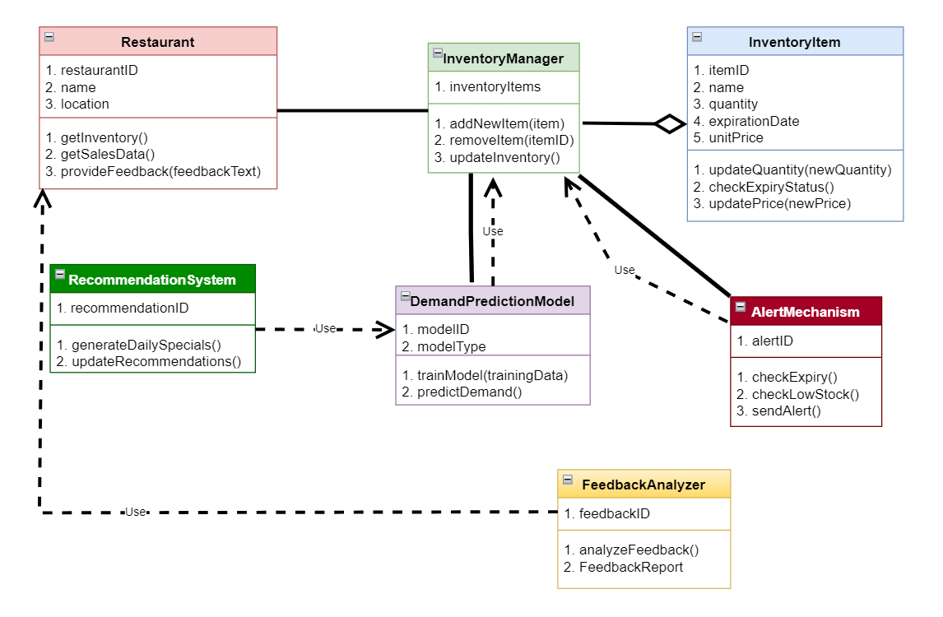
UML Diagram

Slide 16

Conclusion
In conclusion, this project emphasizes the vital role of
efficient food inventory management in the restaurant
industry. It addresses cost reduction, food safety, and sustainability, highlighting their impact on restaurant
success. Leveraging technology like AI, data science, and innovative tools such as alert mechanisms, demand prediction models, and recommendation systems holds significant promise for enhancing inventory efficiency and reducing waste.
In summary, this project underscores how the synergy between technology and strategic inventory management not only benefits the restaurant's bottom line but also contributes to a greener, more sustainable future. By implementing these practices, restaurant owners and operators can take meaningful steps towards reducing food waste, improving efficiency, and enhancing customer satisfaction, ultimately shaping a more responsible and resilient hospitality sector

Slide 17

References
https://unicommerce.com/blog/best-inventory-management-techniques-to-scale-business/
https://www.touchbistro.com/blog/ai-restaurant-applications/#subheading=1
Al-Amin, K. M., Shaikh, A. A., Panda, G. C., Bhunia, A. K., and Ioannis, K. (2020) 'Non-instantaneous deterioration effect in ordering decisions for a two-warehouse inventory system under advance payment and backlogging', Annals of Operations Research, 289, 243-275.
https://www.weforum.org/agenda/2021/06/wasteless-ai-retail-food-waste/

